Slide 1
You can
AN ONLINE CODING PLATFORM
SUBMITTED BY : SRISHTY BANGA
2ND YEAR

Slide 2
ABOUT
“You can” is an online learning platform providing the best experience of learning by doing. We tend to learn more when we do the same thing by our own. This platform provides with the best interactive learning experience in which one can code and compete.
Personalized study plans that cater to various categories from beginner to experts.
Localized video lessons are used to explain even the most complex logic/task easily with simpler examples.

Slide 3
SALIENT FEATURES
Gamification:
A greater exposure to coding is provided along with fun.
People can make their own codes to play games.
Certification:
Authentic certification will be provided after completion of course.
Motivational-Triggers:
Rankings , extra points , coins will be given on the basis of the performance.
We will provide free of cost courses for the ones with weak economic conditions.

Slide 4
Events:
Various online events , competitions , hackathons are organised by “You Can”.
Winners will be awarded with exciting rewards.
Cart:
We provide a separate section containing all the information related to payments of the various courses.
Offers will be provided to those who have more number of coins or more ranking.
Online community:
“You can ” will provide regular online counselling sessions.
A community of learners , beginners , experts and alumani will be build –up.

Slide 5
Feedback:
Feedback from the users will be accepted and actions will be taken .
After login:
Grade will be assigned based on the performance .
Rankings will be given based on comparative perfomance.
Assessments will be provided daily.
Security and authentication:
Access of the courses will be given for lifetime.
Payment methods are secure and believable.

Slide 6
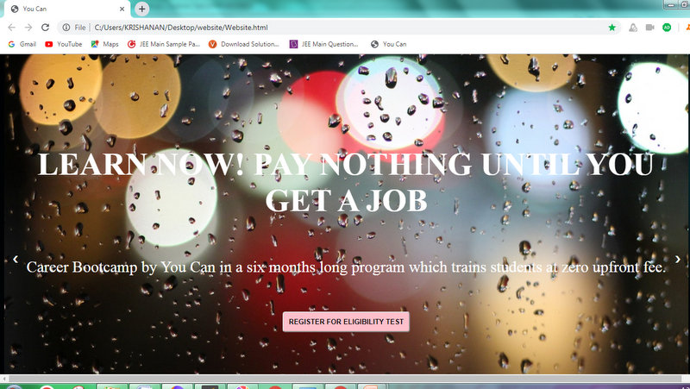
Some Glimpses of “You Can”

Slide 7
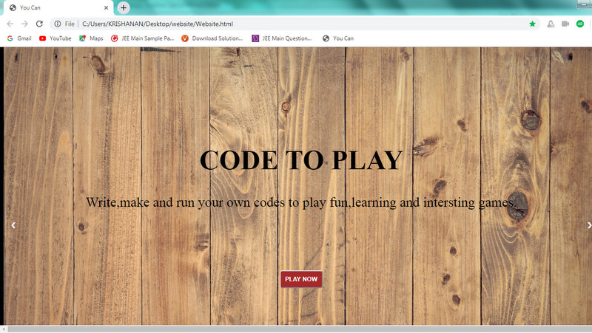

Slide 8
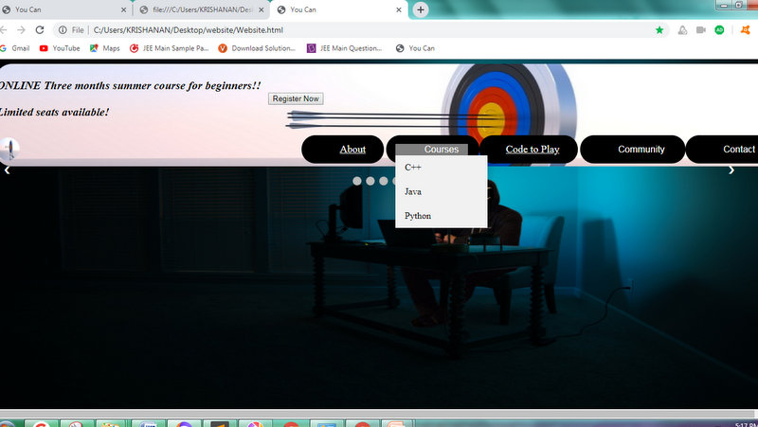

Slide 9
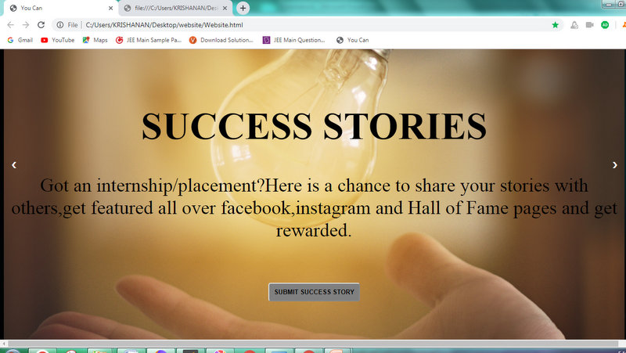

Slide 10
Acknowledgement
This project consumed huge amount of work,research
and dedication. Still,implementation have a support of
would not have been posibble if I didn’t have a support
of platforms like progate, w3schools and more .
Therefore I would like to extend my sincere
gratitude to all of them.

